Slide 1
Extra Activities
Via Eccettuato 7/B, 15033 Casale Monferrato (AL)
Tel. 0142 71091 – 377 7088753
www.britishschoolcasale.com - email: casalemonf@britishschool.com
Mehroo Bhoori

Slide 2
Task Types – Matching Pre-A1 Listening

Slide 3
ANSWERS

Slide 4
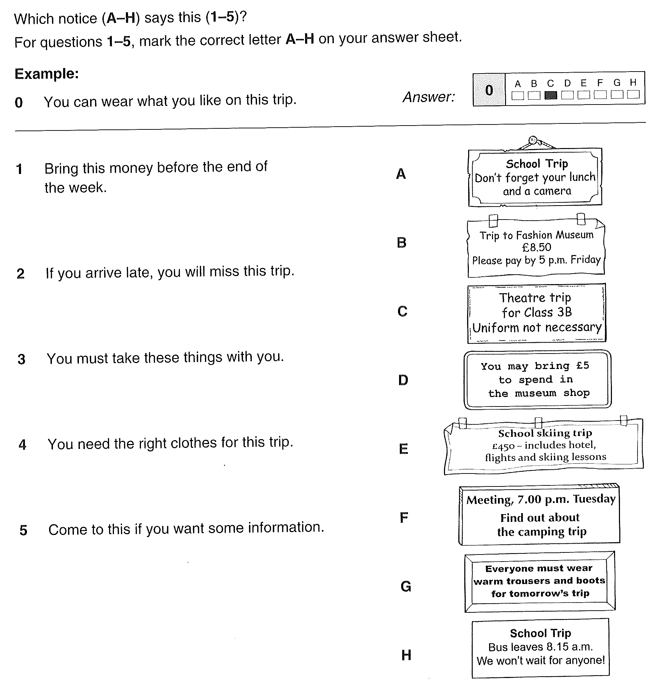
Task Types – Matching A2

Slide 5
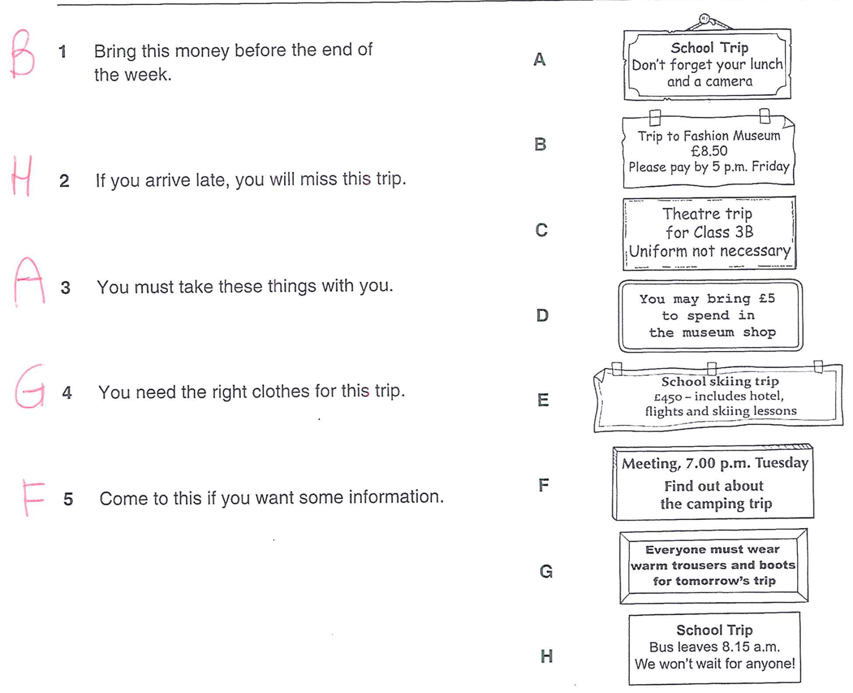
ANSWERS

Slide 6
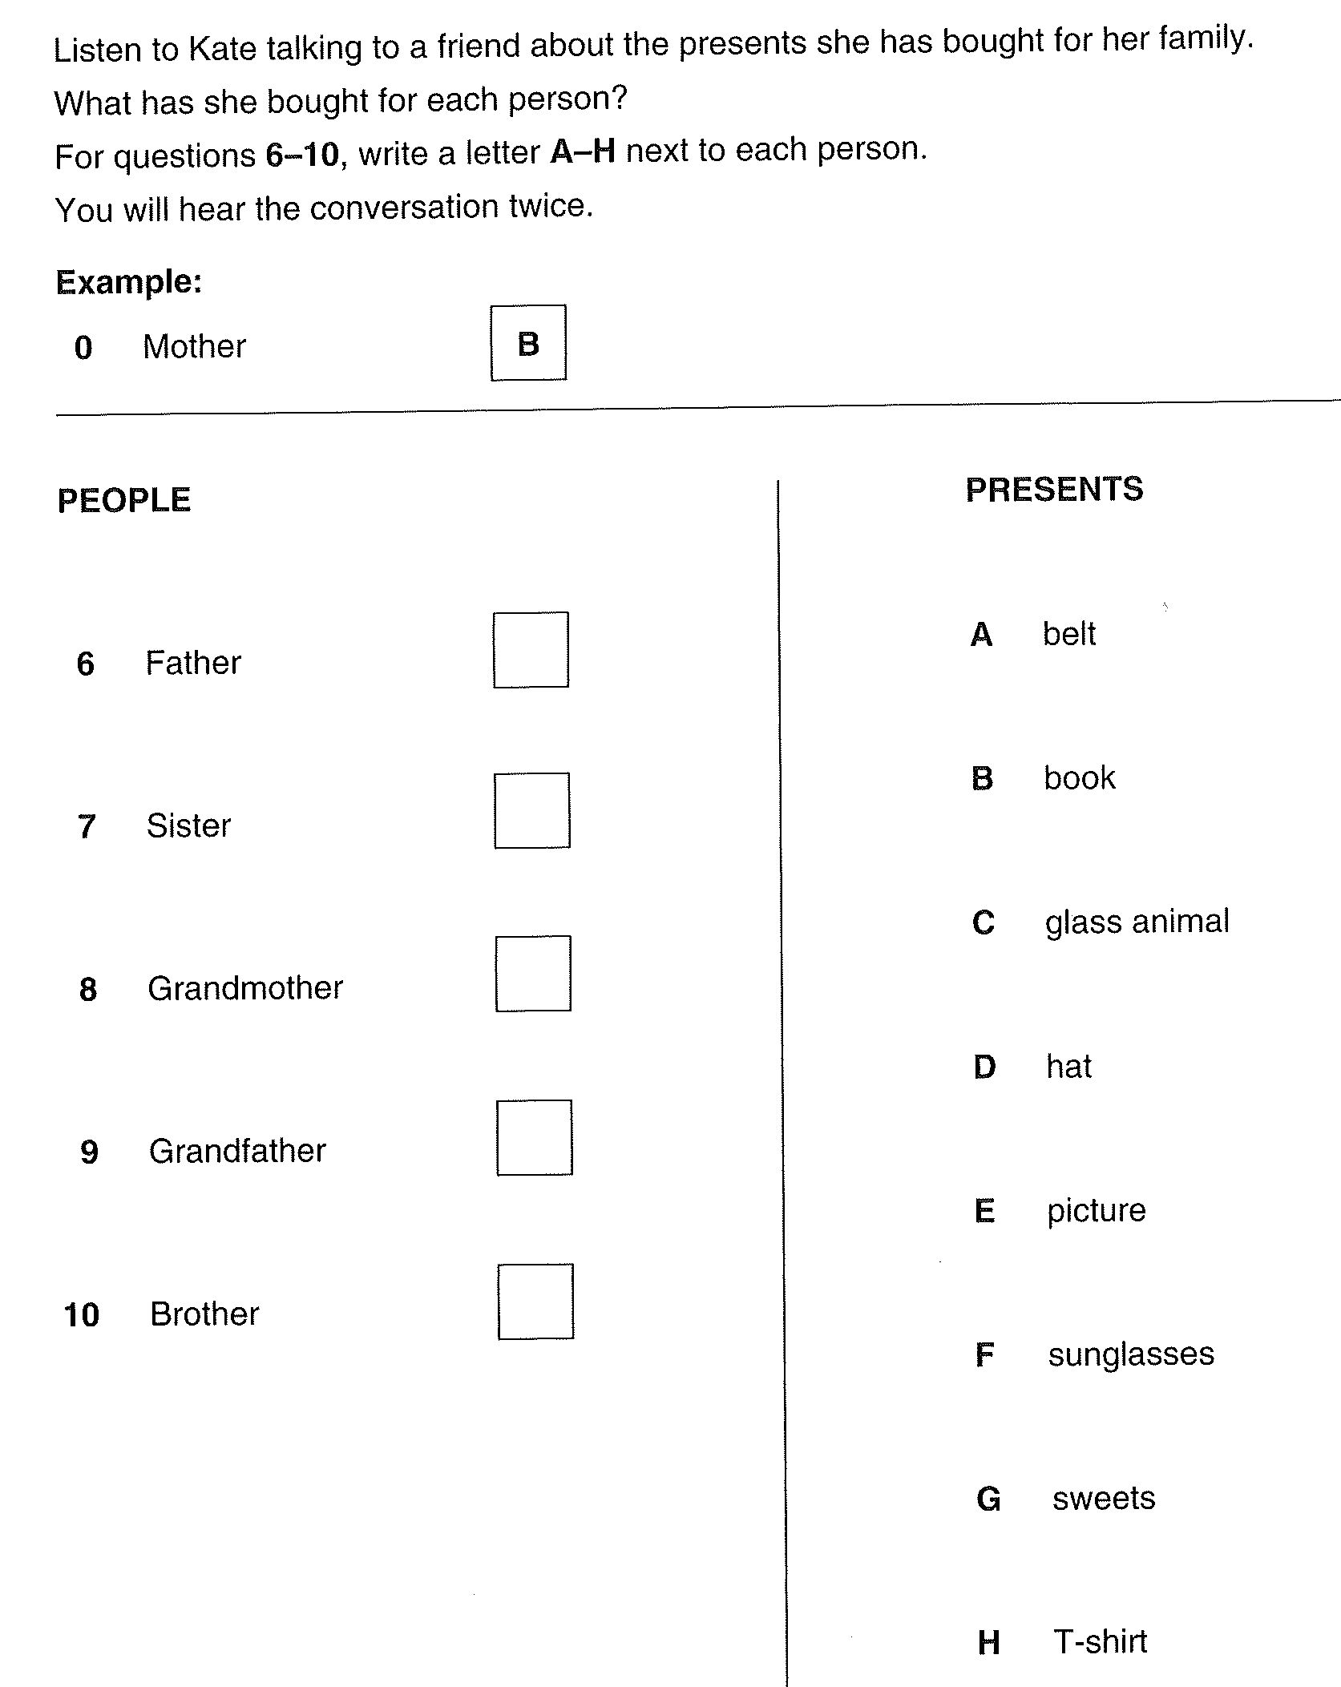
Task Types – Matching A2 Listening

Slide 7
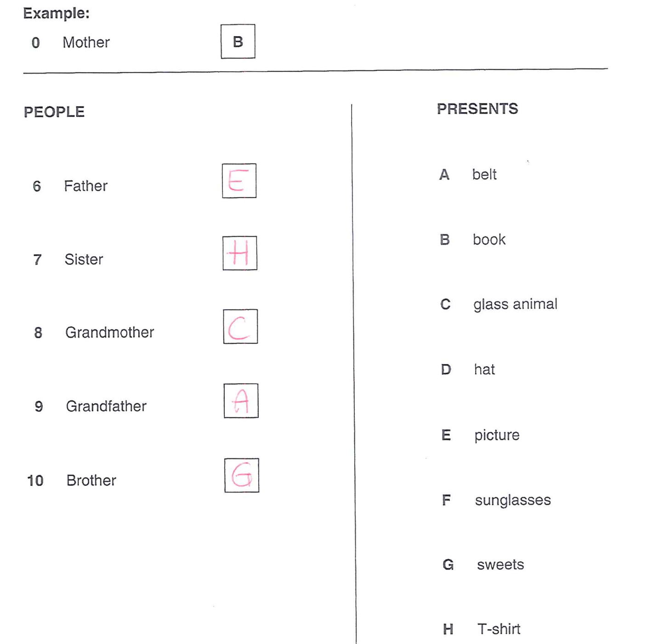
ANSWERS

Slide 8
Task Types – Gap fill Pre-A1

Slide 9
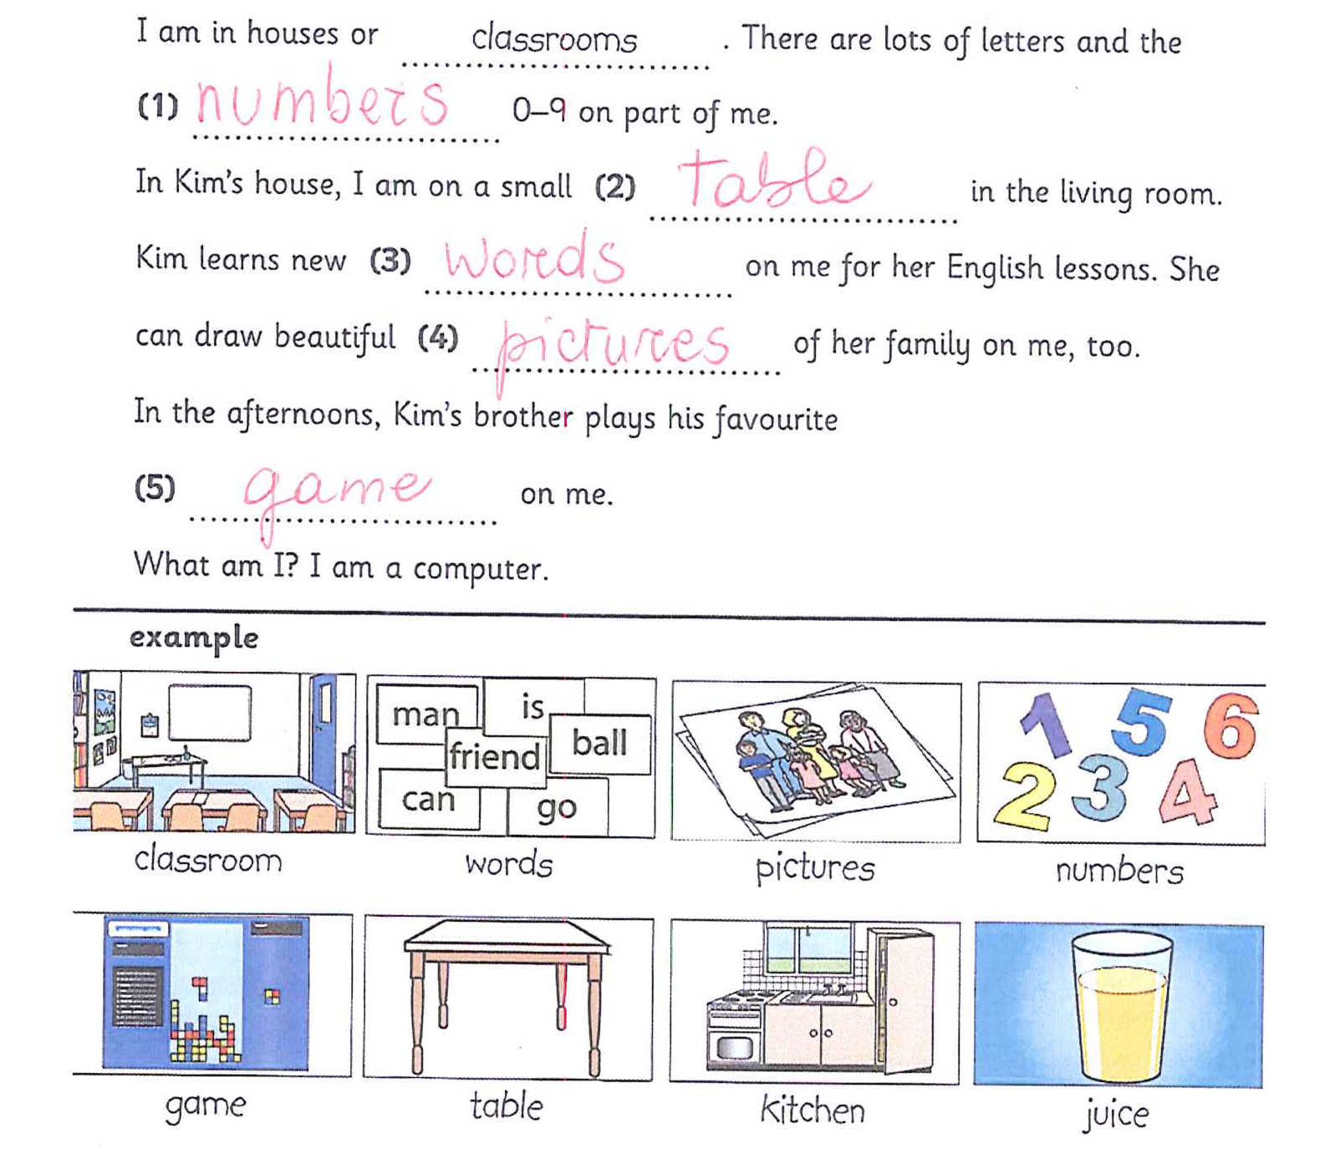
ANSWERS

Slide 10
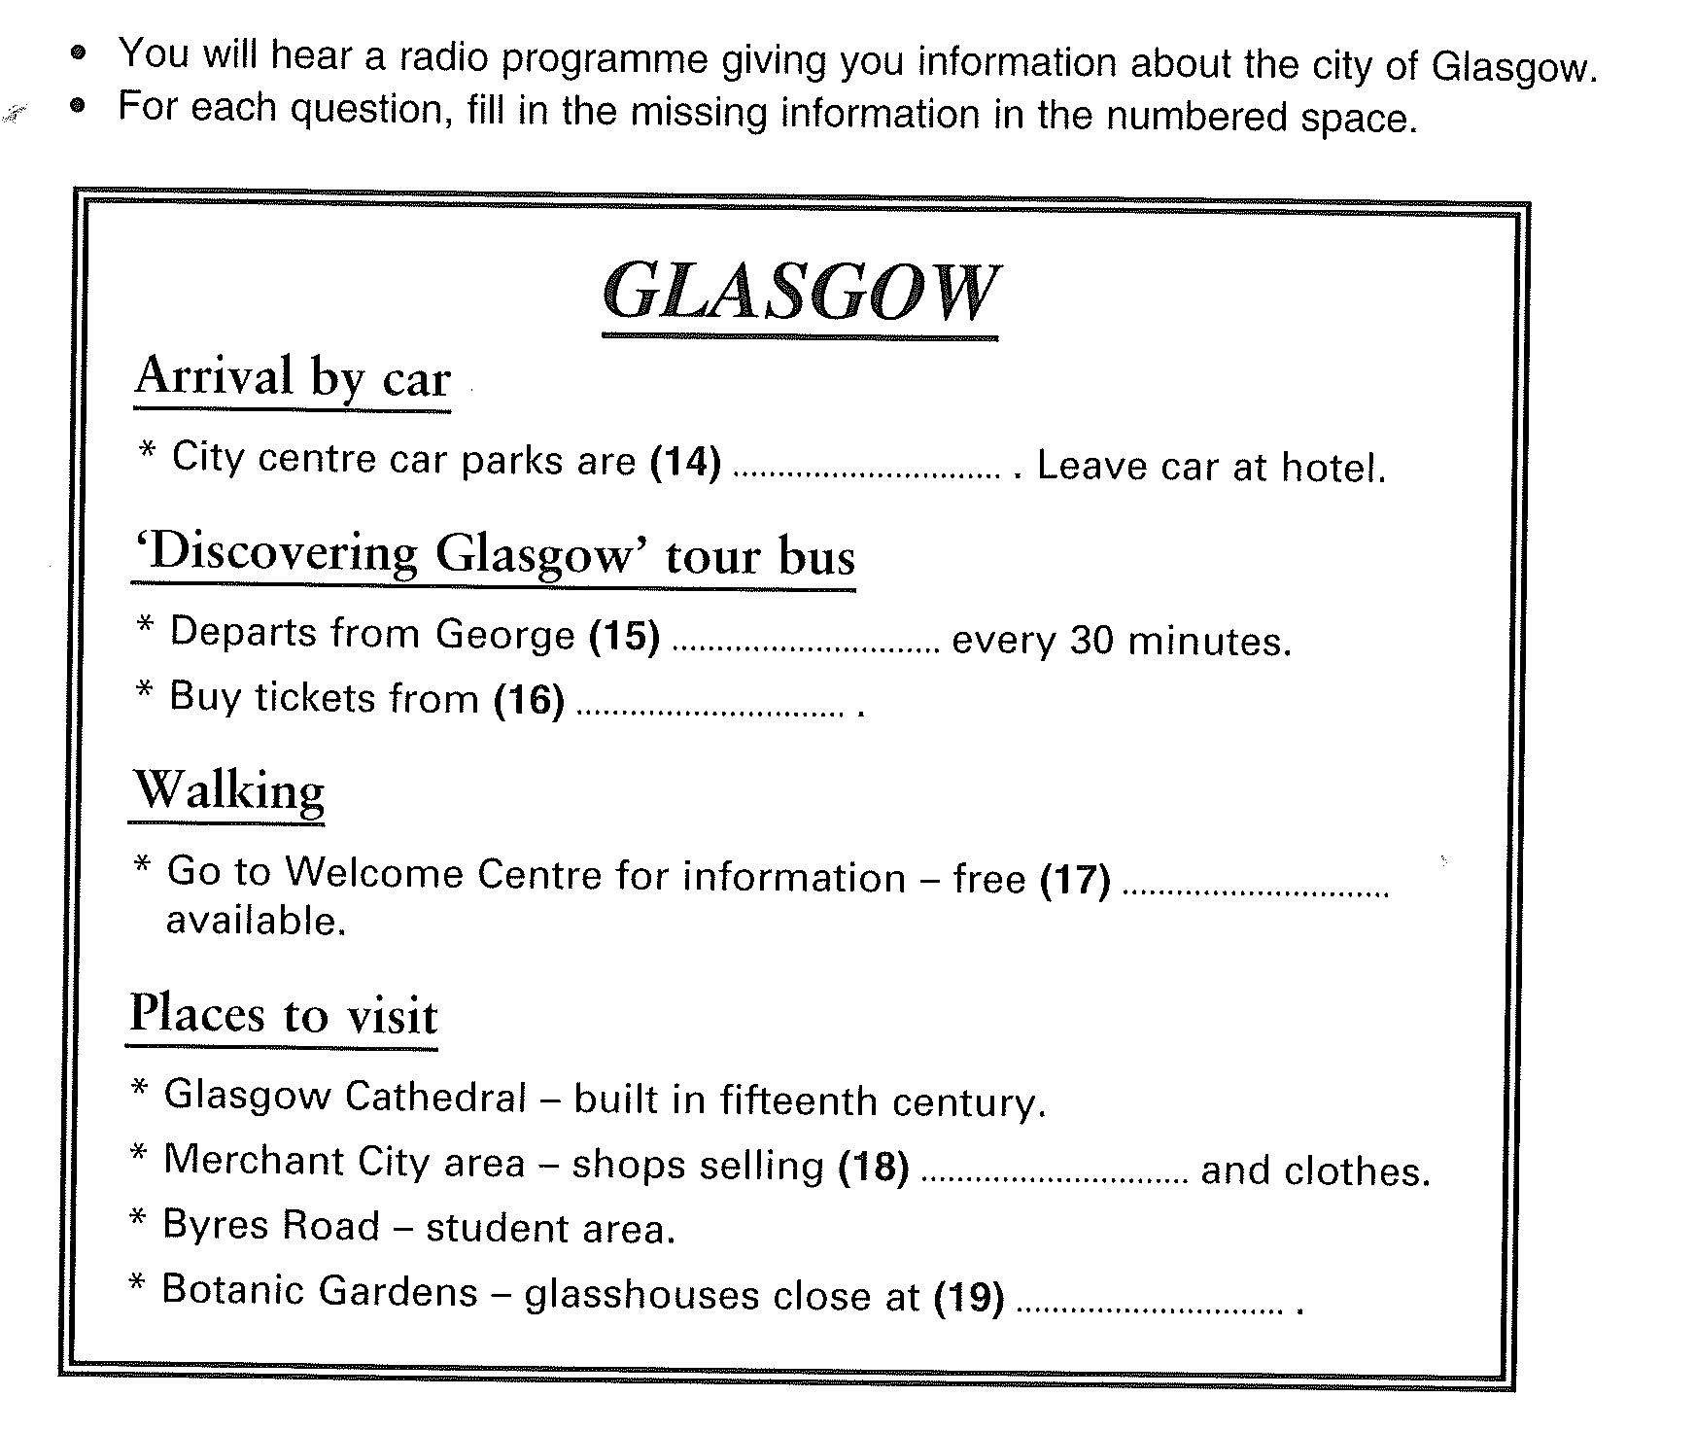
Task Types – Gap fill B1 - Listening

Slide 11
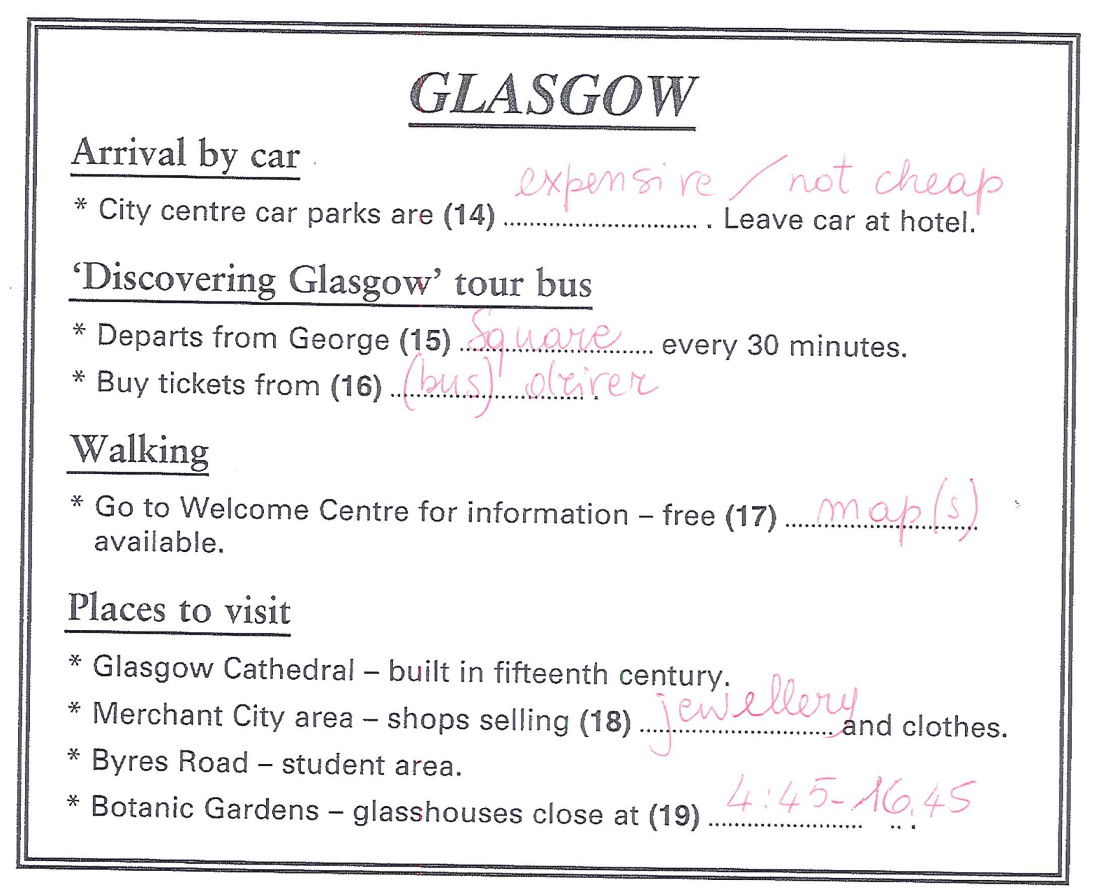
ANSWERS

Slide 12
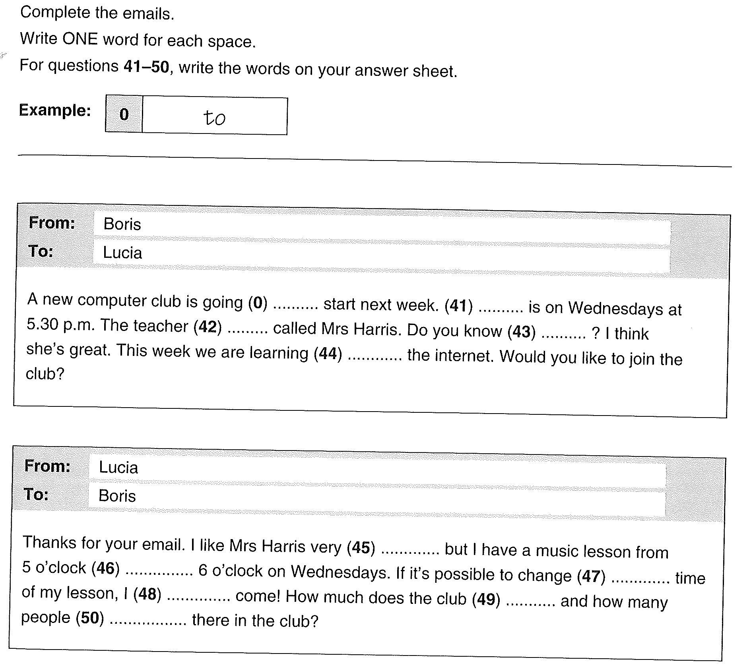
Task Types – Open cloze A2

Slide 13
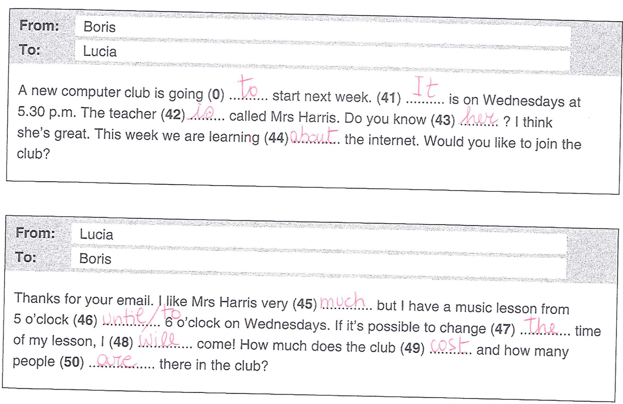
ANSWERS

Slide 14
Task Types – Jumbled Words Pre-A1

Slide 15
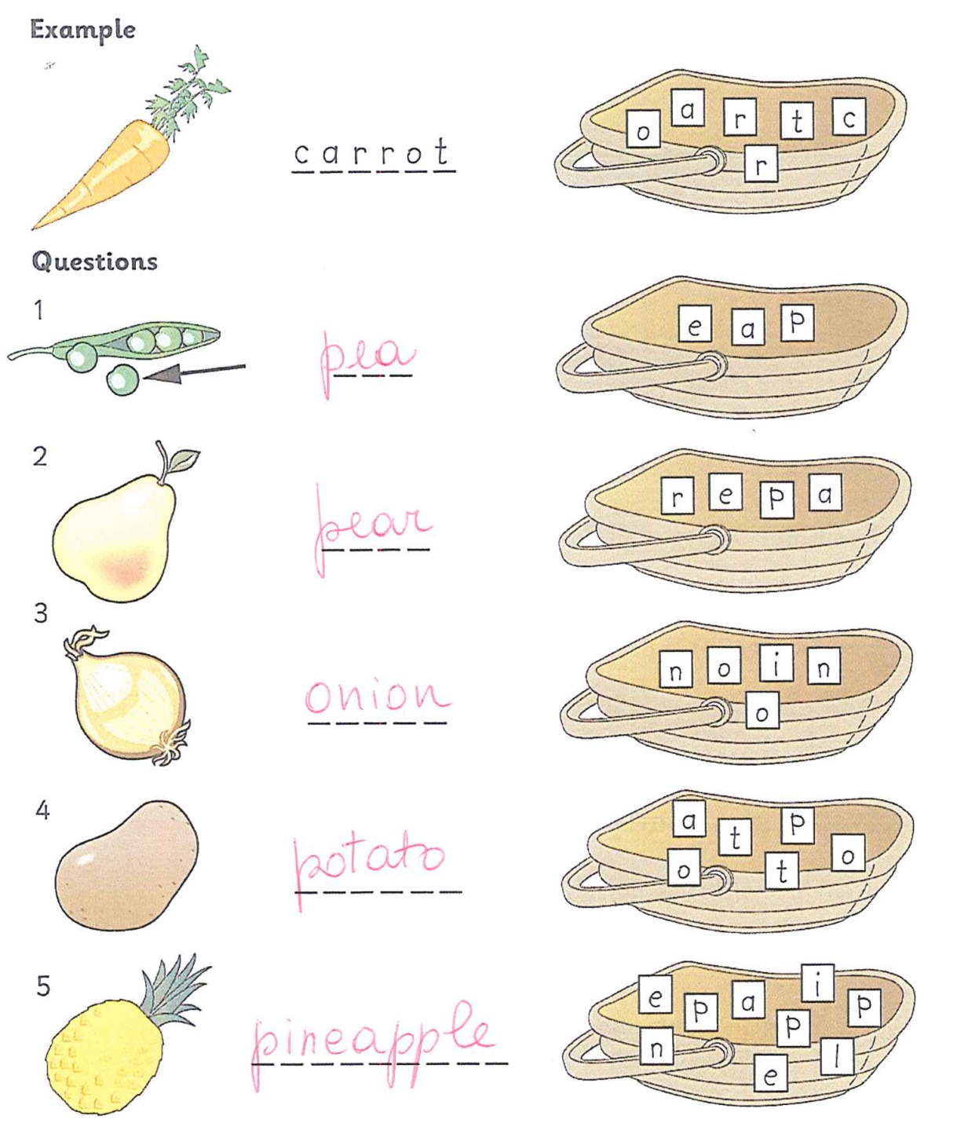
ANSWERS

Slide 16
Task Types – True/False Pre-A1

Slide 17
Task Types – True/False Pre-A1

Slide 18
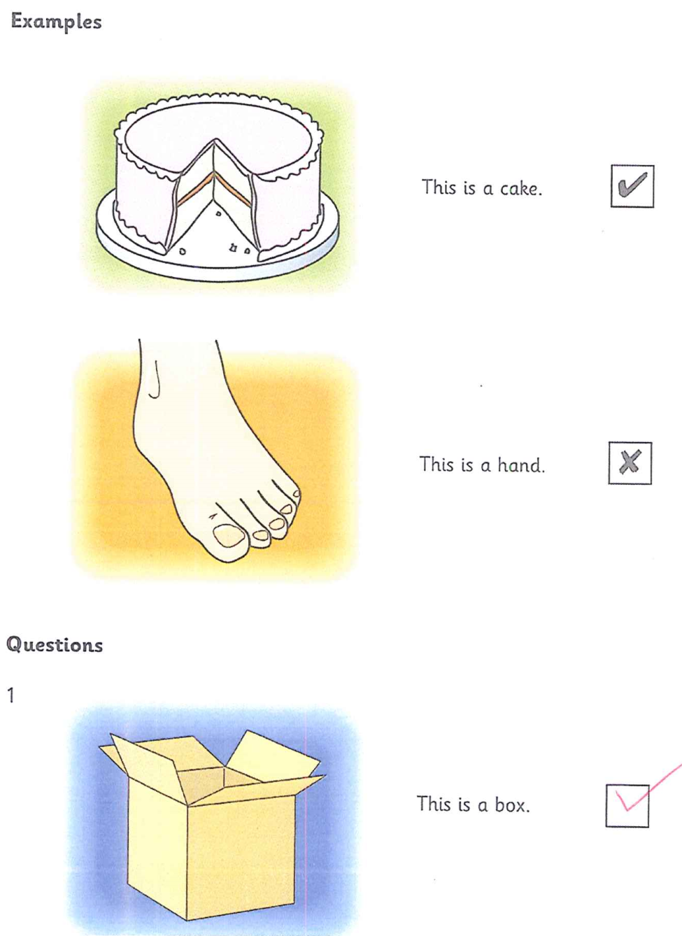
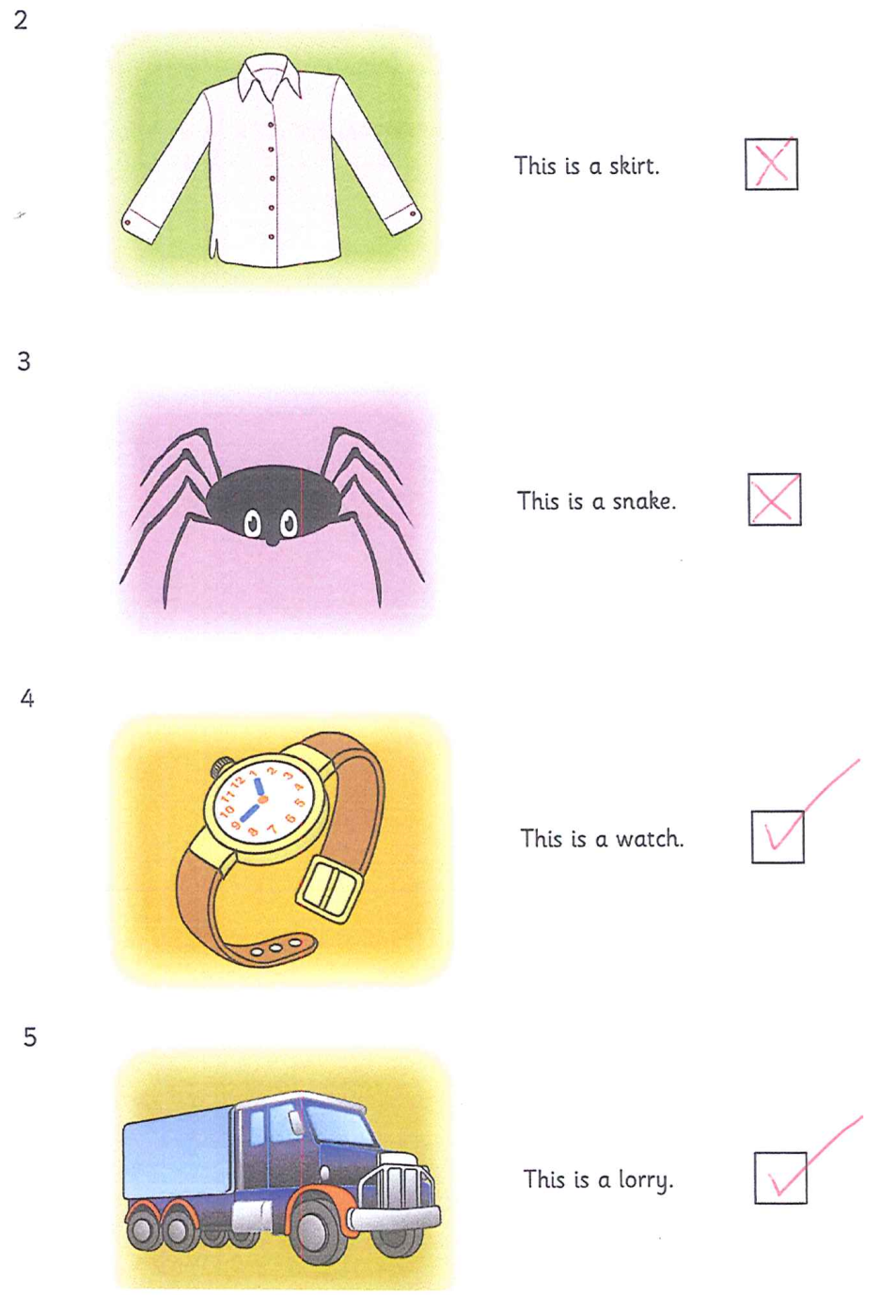
ANSWERS

Slide 19
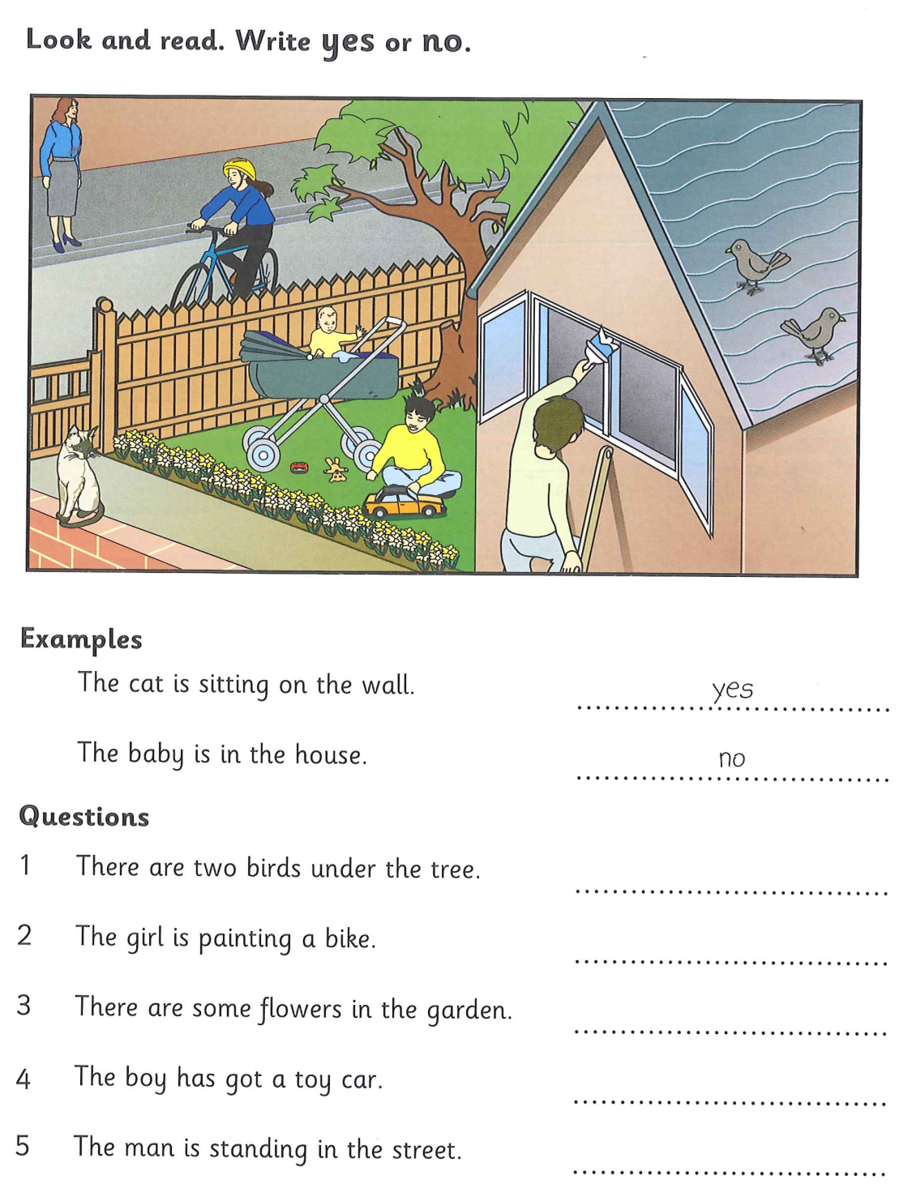
Task Types – Yes/no Pre-A1

Slide 20
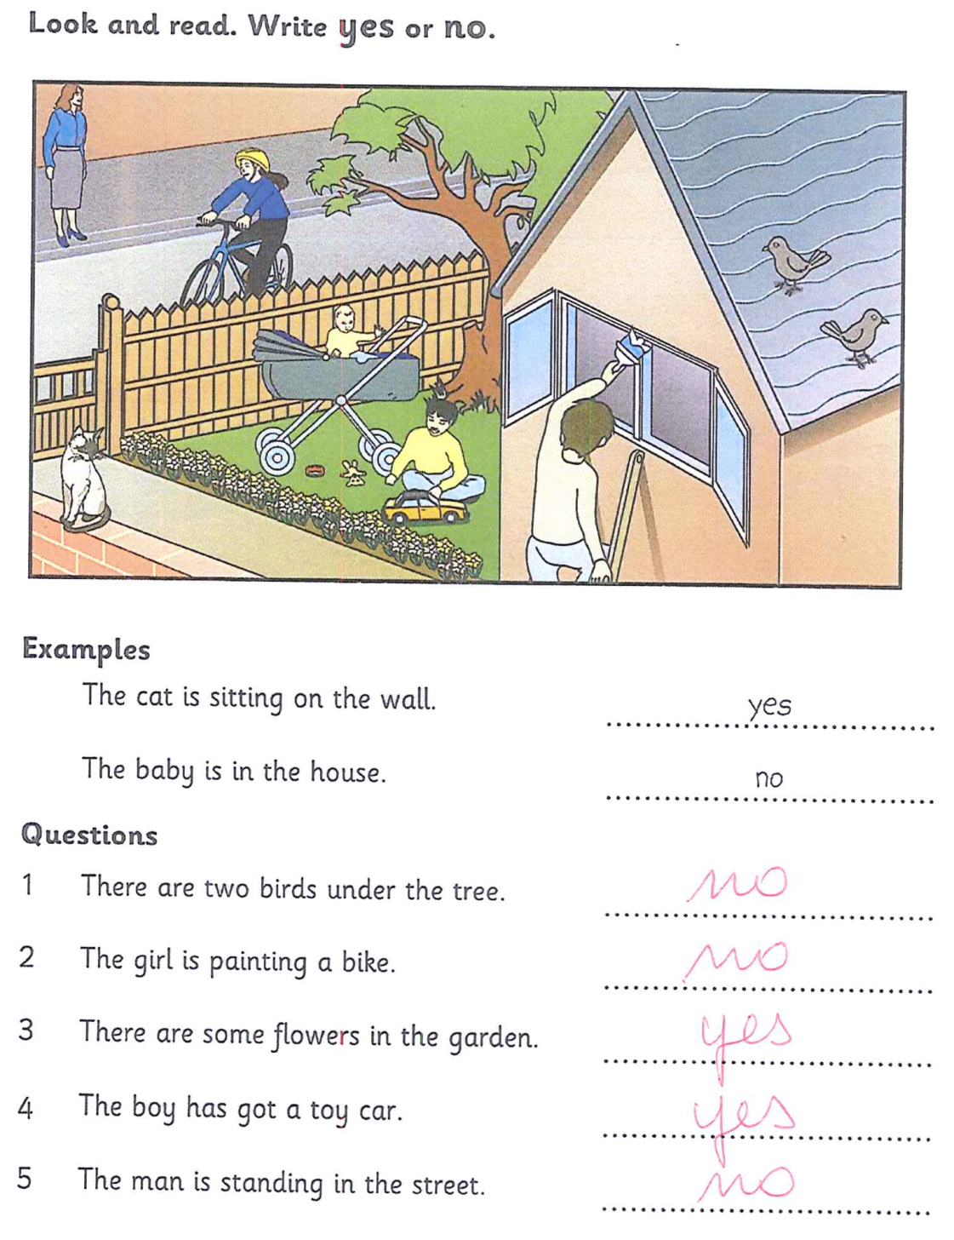
ANSWERS

Slide 21
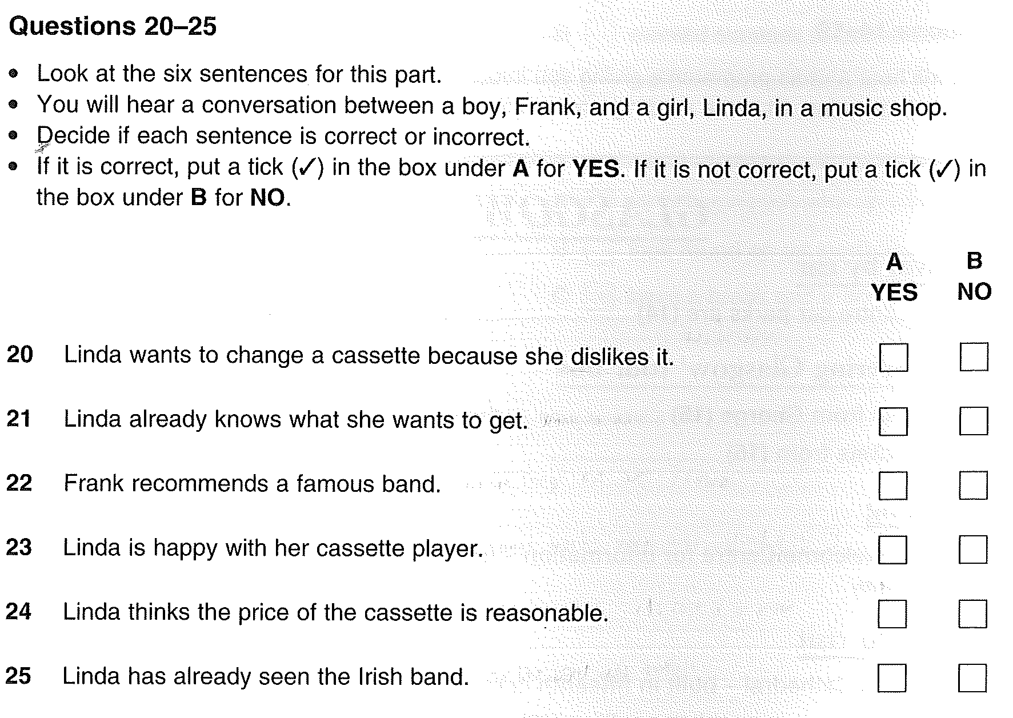
Task Types–Yes/no B1 Listening

Slide 22
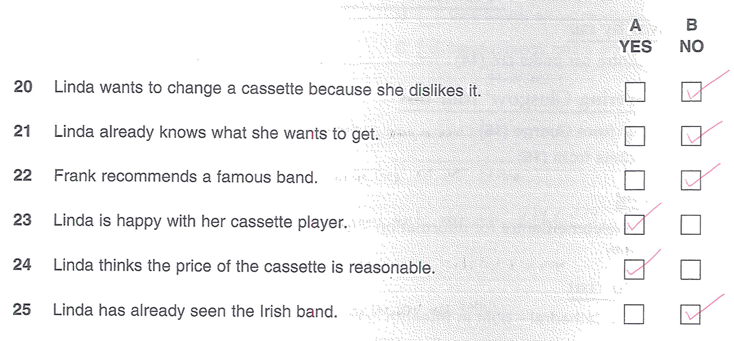
ANSWERS

